Slide 1







DISTRIBUTED DATA PROCESSING PIPELINE

Slide 2



UNDER GUIDANCE OF
PROFESSOR
DR. BHANU K.N.
Presented By Umesh Naik
24PG00021
M.Sc. Data Science

Slide 3

INTRODUCTION
•Explosion of data in modern systems
•Traditional single-machine processing is limited
•Distributed pipelines enable scalable data processing

Slide 4

WHAT IS A
DATA PIPELINE?
•Automated flow of data from source to destination
•Includes ingestion, transformation, and storage
•Ensures consistency and reliability

Slide 5

WHY DISTRIBUTED DATA PIPELINES?
•Handles large datasets efficiently
•Improves performance using parallelism
•Provides fault tolerance and reliability

Slide 6

CORE COMPONENTS OF DISTRIBUTED PIPELINES
•Data Ingestion Layer
•Distributed Storage
•Parallel Processing Engine
•Monitoring & Orchestration

Slide 7
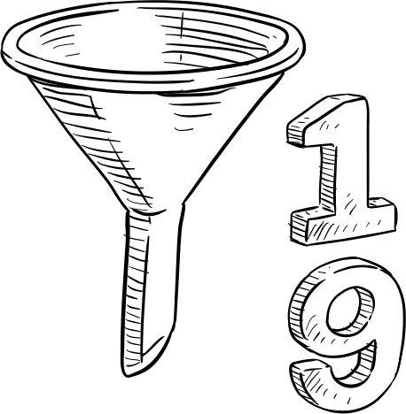
DISTRIBUTED PIPELINE ARCHITECTURE
•Data Source → Ingestion → Storage → Processing → Analytics
•Each stage operates independently
•Supports batch and large-scale processing

Slide 8

SPARK-STYLE PROCESSING MODEL
•Driver program controls execution
•Executors run tasks in parallel
•Data is partitioned across nodes

Slide 9

SCALABILITY & FAULT TOLERANCE
•Horizontal scaling by adding nodes
•Automatic task re-execution on failure
•Data replication ensures reliability

Slide 10
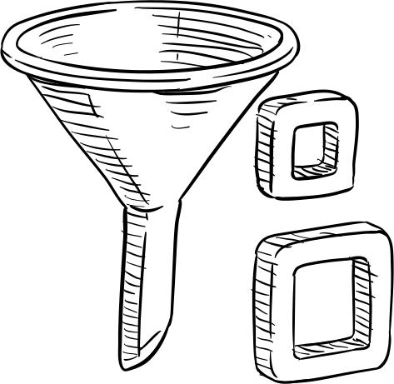
THANK YOU
References:
1) https://www.researchgate.net/profile/Charles-Paul-8/publication/386440210_Distributed_Data_Pipelines_for_Scalability_in_Predictive_AI_Frameworks
2)https://www.irjmets.com/uploadedfiles/paper//issue_3_march_2025/68567/final/fin_irjmets1741206460.pdf
3)https://research.chalmers.se/publication/521248/file/521248_Fulltext.pdf
Dataset: https://www.kaggle.com/datasets/umeshnaik01/sales-transactions

